Slide 1
Supporting Nonexperts in Choosing Appropriate Privacy-Enhancing Technologies
Mohammad Faisal Bin Ahmed, 09/08/2021, Final Presentation

Slide 2
Outline
  Motivation
  Research Approach
    Research Questions
    Design
Findings and Results
  Research Design Related Findings
  PETs
  Criteria
  Mapping PETs with Criteria
  Key Insights
  Web Implementation
    Algorithms
    Demo
Conclusions

Slide 3




Why Privacy Enhancing is Important
Ever-increasing demand for ensuring privacy
More data getting collected and analyzed
Government regulations
Creating business value while maintaining privacy.
Notes:
Privacy in general
Ever increasing amount of data, collected, analysed
Create business value, facilitate research
GDPR regulations
Need pet that allows to derive value without compromise
This is why pet is important.

Slide 4








Numerous Privacy-Enhancing Technologies
Federated Learning
Differential Privacy
Homomorphic encryption
Zero-knowledge proof
Secure multi-party computation
Pseudonymization
Obfuscation
Random data generation

Slide 5



Motivation
So many privacy-enhancing technologies…
Easy to get overwhelmed when choosing
A guideline to solve this dilemma

Slide 6
Research Questions
What are the state-of-the-art privacy-enhancing technologies and their distinct characteristics?
1
What are the different scenarios where privacy enhancement is required and their
corresponding basic requirements?
2
How to guide the decision-making process to allow diverse stakeholders make informed
decisions about the use of an appropriate privacy-enhancing technology?
3

Slide 7
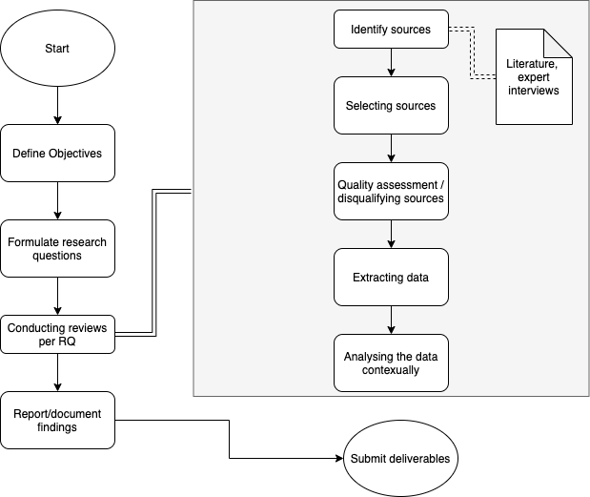
Methodology

Slide 8
Literature searching & classification
Identify initial literatures
Searching generic keywords like: "privacy", "privacy preserving", & "privacy enhancing"
Extracting relevant Keywords
Using SketchEngine to identify search keywords (top 30)
Conducting Secondary search
Exclusion criteria: papers older than 15 years old.
Classification
Excluding keywords specific to a particular PET
Final List of papers
Initially manual classification
Automatic classification based on keyword matching
(12 final search queries)
(3176 total papers)
420 papers after initial results
623 papers after manual adjustments
Removing duplicates
Tools used during the process: Zotero, Publish and Perish, SketchEngine, and Scribbr.

Slide 9
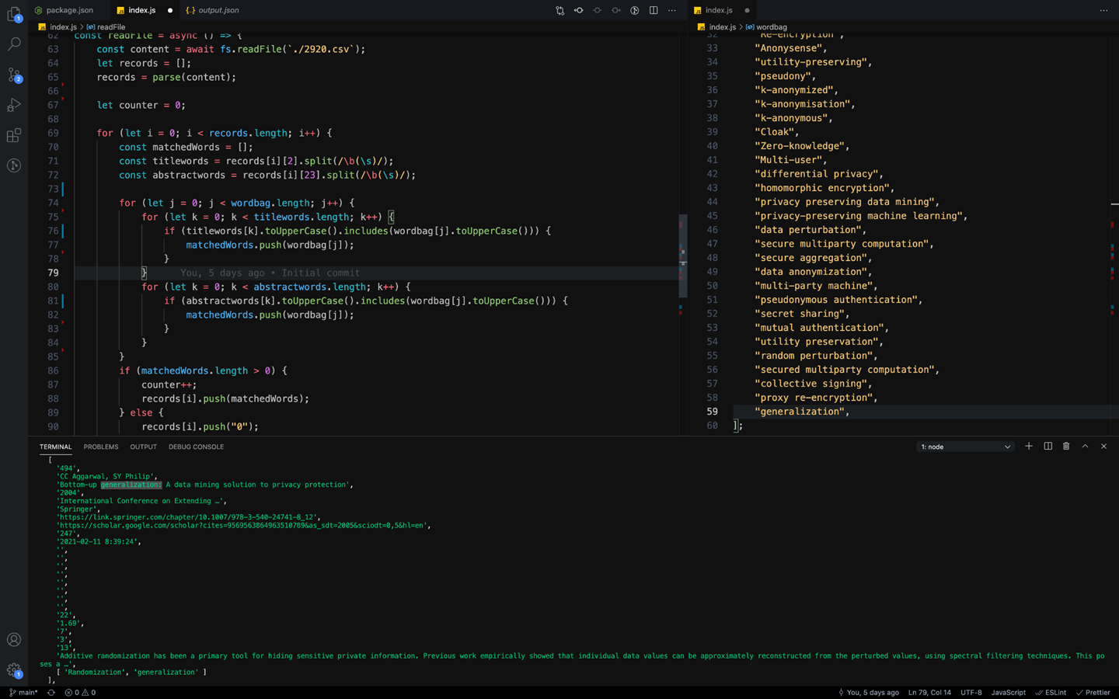
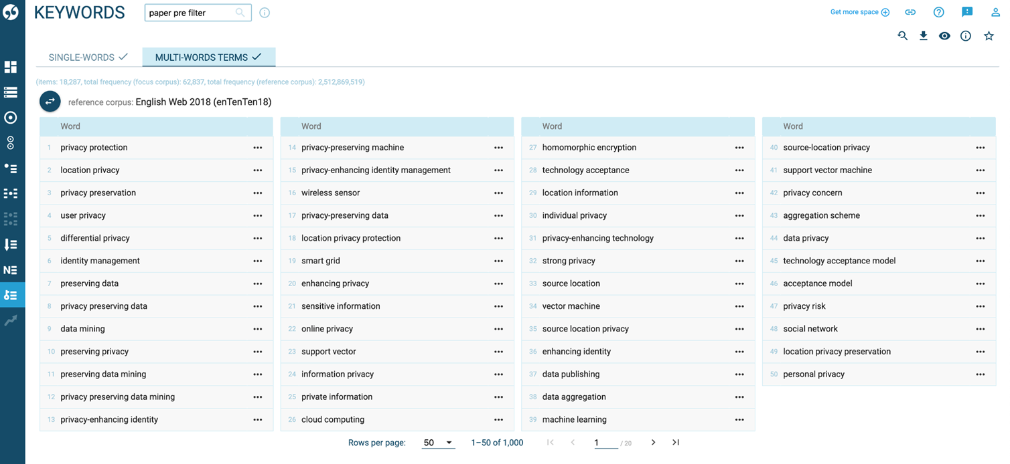
Research Design – A Novel Approach
Systematic Literature Review using automated classification.
Using tools like SketchEngine and a Node application to automatically reduce manual filtering complexity and errors.
Classification of ~3600 sources done in hours instead of days.
Fig: SketchEngine corpus
Fig: classification program

Slide 10
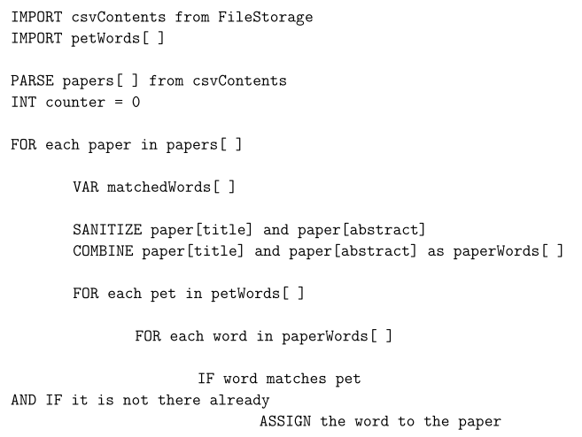
Classification Automated
1. Extracting keywords with SketchEngine
2. Create List of Words (PET)
3. Assign Keyword(s) to each paper
Match a paper's title and abstract with the List of Words.
Identify PET keywords (including different grammatical variants)
Using titles and abstracts
4. Manual Keyword searching
5. Repeat steps 2-4 until all papers are scanned
Search unassigned papers manually to extract new PET keywords
Assign PET keywords if matched
“Anonymization”
“Randomization”
“K-anonymity”
Manually searching through 2000 single & multiword keywords
“Obfuscation”
“Zero knowledge”
…

Slide 11
Adding PET tags to the sources
PET tags

Slide 12
Automated Process in Numbers
Table: Number of sources after manual adaptation
 | Before manual adaptation | After manual adaptation
Keywords | 48 | 53
Matched papers | 420 | 623
Table: Time saving of the automated classification process
 | Before automation (in hours) | With automation (in hours)
For the first 406 papers | ~ 9 | N/A
For the next 3176 papers | ~ 70 | ~ 8

Slide 13
Identified PETs
Differential Privacy
Obfuscation
T-closeness
Federated Learning
Data Perturbation
Pseudonymization
Zero Knowledge Proof
Anonymization
Randomization
Homomorphic Encryption
K-anonymity
Synthetic Data Generation
Secure Multiparty Computation
L-diversity

Slide 14
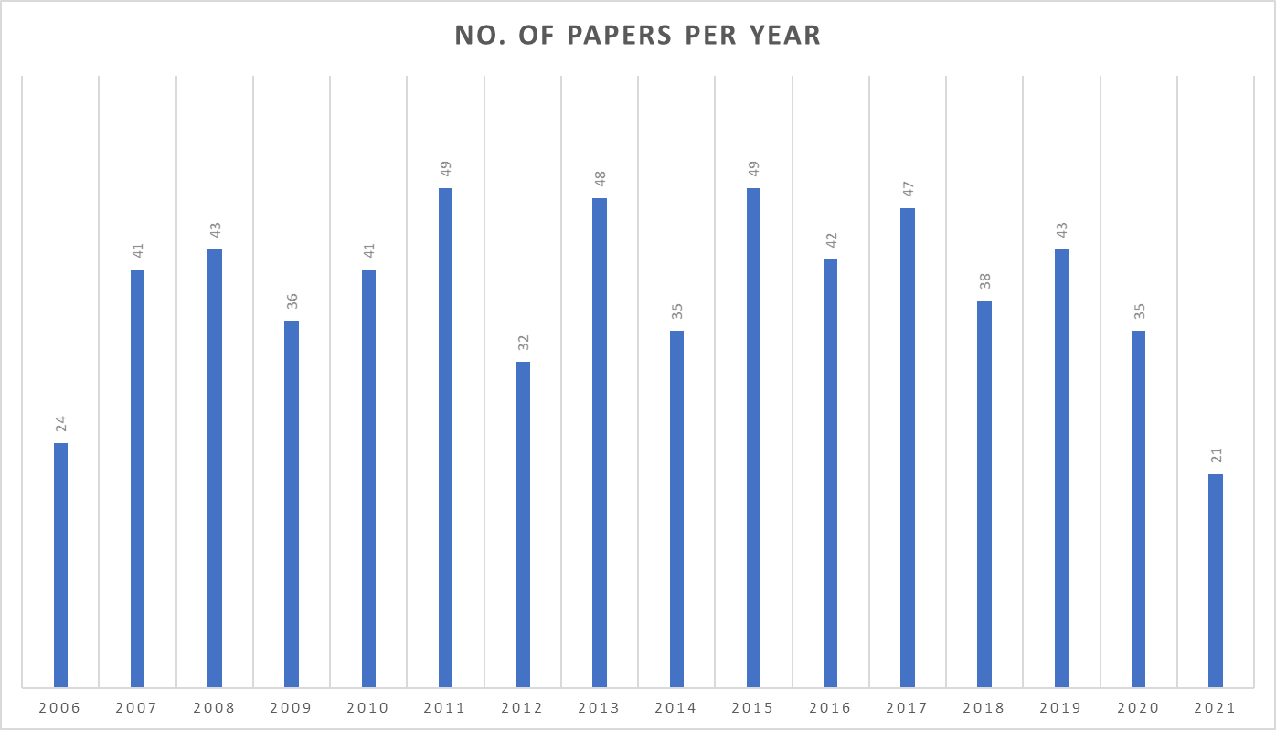
General trend (or lack thereof)
Notes:
No trends due to tool fetching most cited ones first

Slide 15
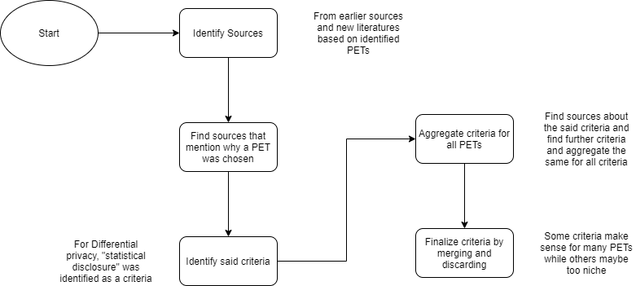
Methodology – Criteria Identification

Slide 16
Identified Criteria
Name | Description
Statistical Disclosure | When statistical disclosure control is needed
Data Publication | If the data will be published
Distributed Data | When the data is stored in multiple locations
Edge Devices | Whether private data leaves user devices or processed locally
Data Transportation | Data in transit
Need of Real Data | Some use cases do not require real data
Computational Cost | The memory and processing cost of a technology
Multiple Stakeholders | When more than one data stakeholders is present
Third Parties | If the data is shared with third parties
Losslessness | Lossy vs lossless enhancing technology
Accuracy | Consistency of the technology
Textual Data | Text-based vs non-textual data
Data Dimension | Some technologies are better suited higher dimensional data

Slide 17
How the data is mapped
Table: Example of the mapping data table
PETs/criteria | Statistical disclosure | Lossless | Textual data | Data transported
Differential Privacy | 1 | 0 | ? | N/A
Table: Legends explaining value types
Value | Meaning
0 | The PET does not fulfill said criteria
1 | The PET fulfills the criteria
? | No sources containing clear relation found yet
N/A | Not applicable/relevant for the said criteria

Slide 18
Mapping data table
Table: mapping data table
 | Statistical Disclosure | Data publication | Distributed data? | Edge devices | Data transported | No need of real data | High Computational cost | Multi Stakeholders | Third party involved | lossless | Accuracy not important? | Textual data | Higher Dimension(k-t-l)
Differential Privacy | 1 | 1 | 1 | 1 | N/A | 1 | 0 | 1 | 1 | 0 | 1 | ? | N/A
Federated Learning | ? | ? | 1 | 1 | 1 | ? | 1 | 1 | 1 | ? | 1 | ? | N/A
Zero Knowledge proof | ? | 1 | ? | ? | 1 | 0 | ? | 1 | 1 | 1 | ? | N/A | N/A
Homomorphic Encryptions | ? | N/A | ? | 1 | 1 | ? | 1 | ? | 1 | 1 | ? | N/A | N/A
Secure Multiparty Computation | ? | ? | 1 | N/A | 1 | ? | 1 | 1 | 1 | 1 | ? | N/A | N/A
Obfuscation | ? | 1 | N/A | N/A | N/A | ? | 1 | ? | N/A | 1 | 1 | ? | N/A
Data Perturbations | 1 | 1 | N/A | N/A | N/A | ? | 0 | ? | N/A | 0 | 1 | ? | N/A
Anoymization | 1 | 1 | ? | N/A | N/A | ? | N/A | 1 | 1 | 0 | 1 | 1 | N/A
K-anonymity | 1 | 1 | ? | N/A | N/A | ? | 0 | 1 | 1 | 0 | 1 | 1 | 0
L-diversity | 1 | 1 | ? | N/A | N/A | ? | 1 | 1 | 1 | 0 | 1 | 1 | 0
T-closeneess | 1 | 1 | ? | N/A | N/A | ? | ? | 1 | 1 | 0 | 1 | 1 | 1
Psuedonymization | 0 | 1 | ? | N/A | N/A | ? | 0 | 1 | 1 | 0 | 1 | 1 | N/A
Randomization | 1 | 1 | ? | N/A | N/A | N/A | ? | N/A | N/A | 0 | 1 | ? | N/A
Synthetic Data Generation | 1 | ? | ? | N/A | N/A | 1 | 1 | N/A | N/A | 0 | 1 | 1 | N/A

Slide 19
Key Insights
Manual vs automatic classification | Manually searching or filtering through thousands of sources for classification is time consuming, prone to human errors and biases.
Similarity with other fields | Privacy enhancing technology related keywords sometimes result in getting papers from mathematics and medical backgrounds.
Grammar variants | While creating the list of words in the classification phase, one must include all the grammatical variants for the keywords for optimal results.
Spelling matters | Some search terms provide more results than other. For example: ’privacy technique’ has fewer number of results compared to ’privacy technology."
Dominant term | ’Privacy enhancing’ is more dominantly used in academia than ’privacy preserving.’ Although these two terms are used interchangeably.
Subset technology | Many privacy enhancing technologies are a subset of a larger privacy enhancing technology. For example: k-anonymity and l-diversity for anonymization.
Anonymous | Many novel privacy enhancing technologies do not mention their name, or do not propose a new name for their technology in the title/abstract of the paper. For example: ’a privacy enhancing technique for k-means clustering in data mining.’

Slide 20
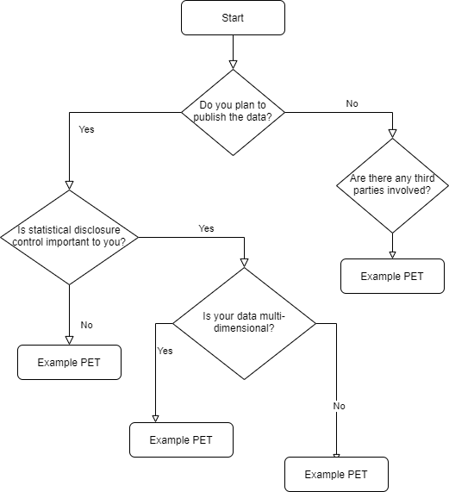
Example PET Decision Chart

Slide 21



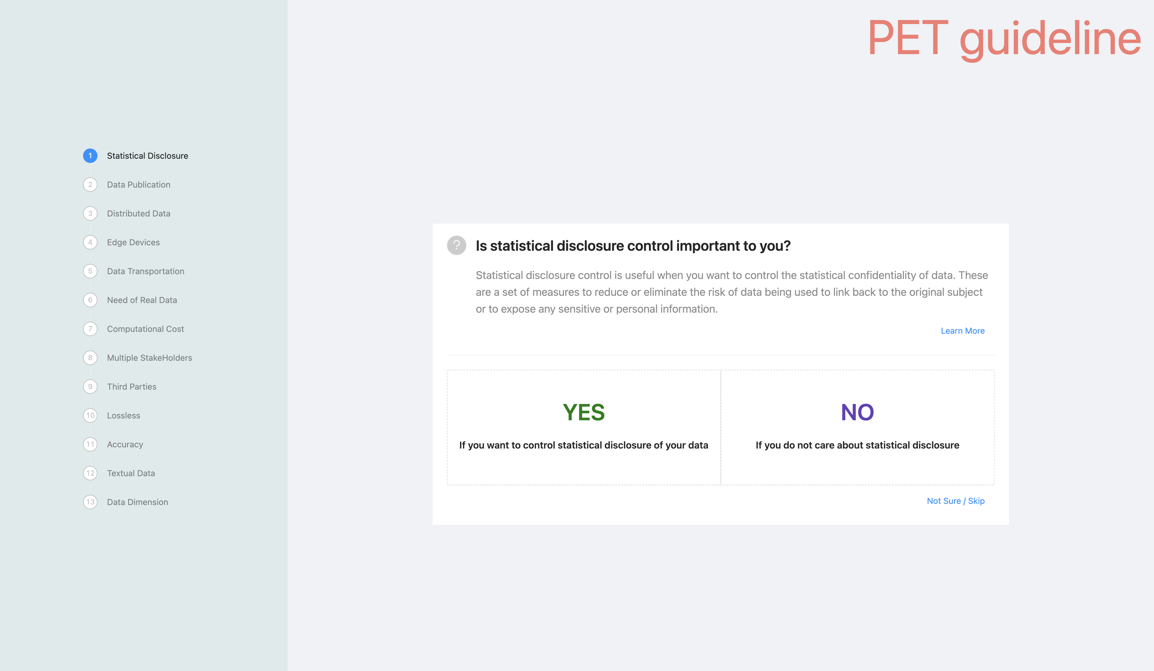
Web App Architecture
Technologies used: React, NextJS, Ant Design
Application modes:
Easy mode – Ask all questions. (default)
Strict mode – Dynamically adjusts questions.

Slide 22
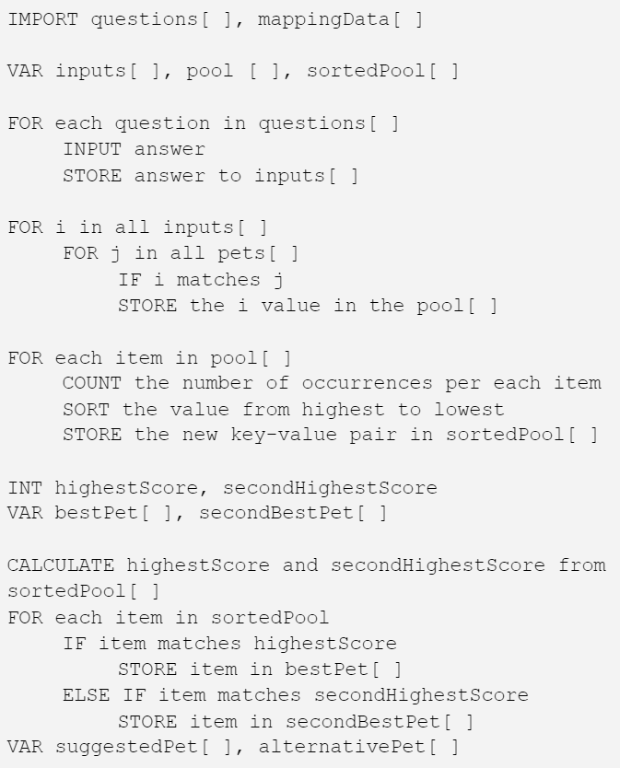
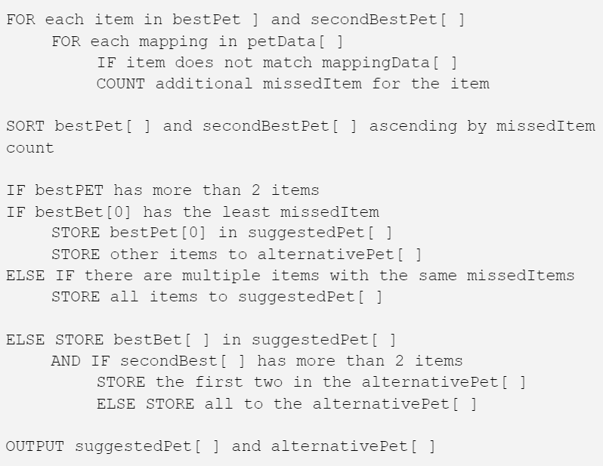
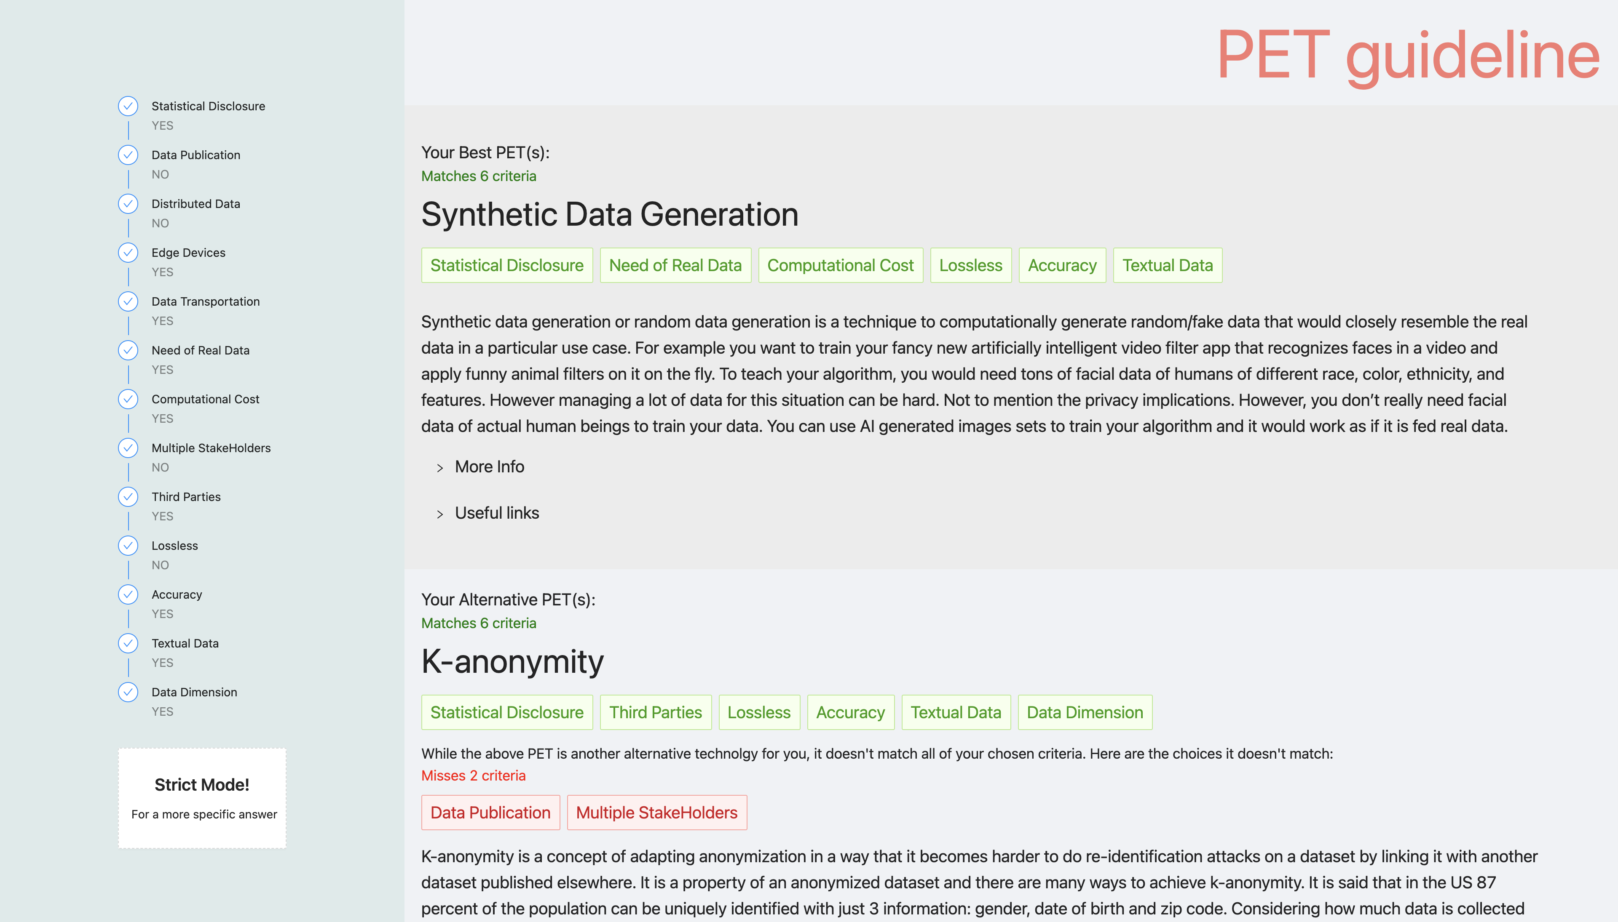
Easy Mode
It is used as the default mode because:
Nonexperts may not be sure about a specific criteria.
Many criteria aren’t deal breaker for specific use cases.
The data isn’t conclusive.

Slide 23
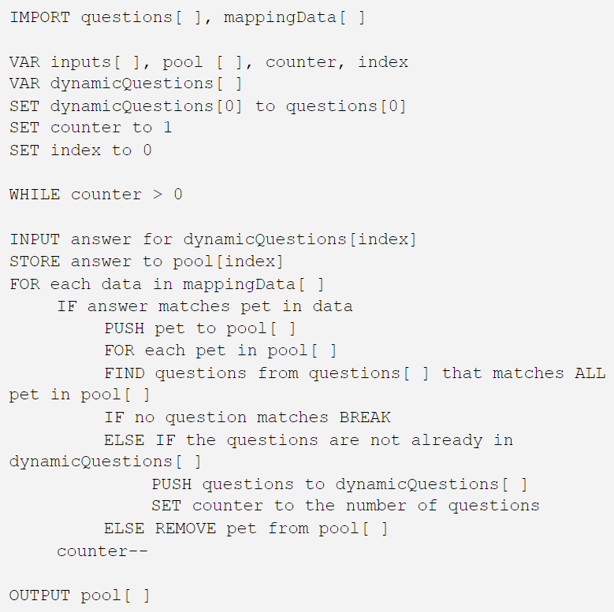
Strict Mode
Dynamically changes criteria/questions to be asked.
Strictly follows the mapping data relations.
Can be used alongside the Easy Mode

Slide 24
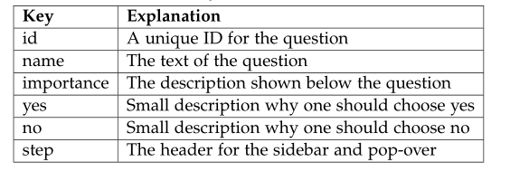
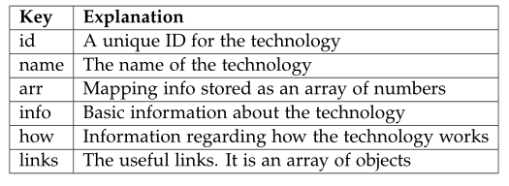
Data Schema
Table: question data schema
Table: PET data schema

Slide 25

DEMO

Slide 26
Conclusion
RQ1:
Identified privacy enhancing technologies and the distinct characteristics.
Identified how a particular technology works.
14 Privacy-enhancing technologies.
RQ2:
Identified specific requirements/criteria that are used to choose a particular technology.
13 criteria.
RQ3:
Identified an appropriate way to help nonexperts choose a particular technology.
A web implementation of the “easy mode” algorithm.
Byproduct:
Showcases a novel way to conduct systematic literature review.

Slide 27
Limitation and Future Work
Limitations:
Lack of concrete data linking different criteria and PETs.
Lack of similar research regarding creation of decision support guideline based on Systematic Literature Review.
Lack of standardized classification of PETs.
Future Work:
Formal feedback and user testing of the web app, usability improvements.
More conclusive data.
Integration with general privacy recommendation platform.

Slide 28
Faisal Ahmed
17132
Faisal.ahmed@tum.de

Slide 29
Backup Slides

Slide 30
Potential scenario
Felix is a tech lead at a VoD start-up in Munich. He wants some analytics to improve their performance, but he can’t send the data to a third-party analytics firm without ensuring proper privacy preserving first. The data they collect includes name, age, UUID, watch history, device info, and payment info. What type of privacy-enhancing technology should Felix use to ensure the privacy of the data subjects is not violated during the analysis?
Concerns: user privacy, potentially malicious analytics firm, data breach during transit or rest, GDPR violation.
Solution 1: spending countless hours to research all the different privacy-enhancing technologies and their pros and cons.
Solution 2: using this systematic research as a guidebook and answering a few question to get a suitable privacy-enhancing technology for his scenario. In this case Homomorphic Encryption!

Slide 31
Lessons learned
Manually searching/filtering through thousands of literature is time consuming, prone to human errors and bias.
PET related keywords sometimes result in papers from Mathematics and Medical backgrounds.
While creating the List of words, one must include all the grammatical variants for the keywords for optimal results.
Some search terms provide more results than other: ‘privacy technique’ has less results compared to ‘privacy technology’
‘Privacy enhancing’ is more dominantly used in academia than ‘Privacy preserving’ although they both are used interchangeably
Many PETs are subset of a larger PET.
Many novel PETs don’t mention their names in the title/abstract of the paper; they mostly just go by the attack they protect against i.e., “a privacy enhancing technique for k-means clustering in data mining”

Slide 32
Easy Mode - Pseudocode

Slide 33
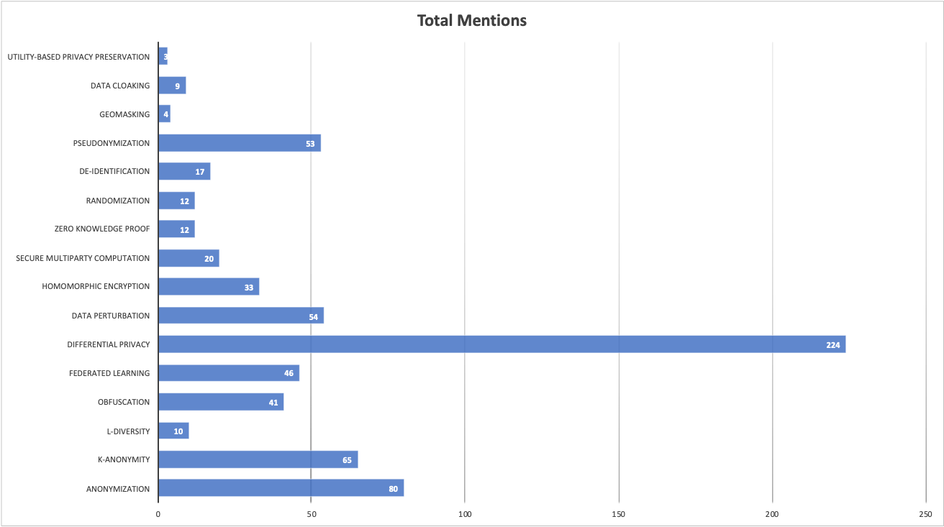
Initial PET Findings
Privacy enhancing technologies - initially identified: 16
After merging – final number: 14

